Slide 1

Evaluating Benchmarks for SGD Classifier
Landon Buell
14 Feb 2020

Slide 2
Classification Benchmarks
Precision, Recall, F1 Score

Slide 3
Precision Score

Slide 4
Recall Score

Slide 5
Accuracy Score

Slide 6
Stochastic Gradient Descent Classifier
“The Heart of All Learning Algorithms” (Goodfellow)

Slide 7
SGD Classifier
Basic Linear Model Classifier
Many algorithms use some variation of this
(Goodfellow)
Uses the gradient of a decision function
(Sanderson)
Very powerful, Very slow
Used on 10,000 figures of MNIST data set

Slide 8
MNIST DATA
Collection of 70,000 images of hand-written figures
Arranged into 28 x 28 pixel arrays
For this test, I use the first 10,000 images
Split into 8,000 training figures, 2,000 testing figures
Permutated w/ numpy library

Slide 9
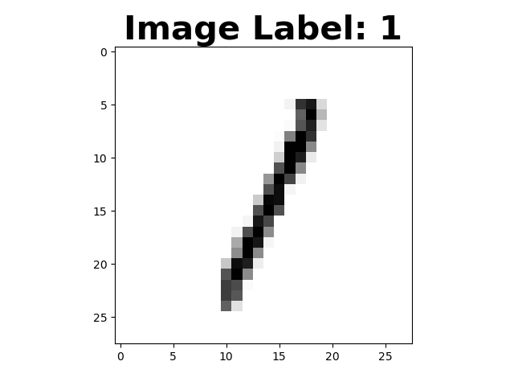
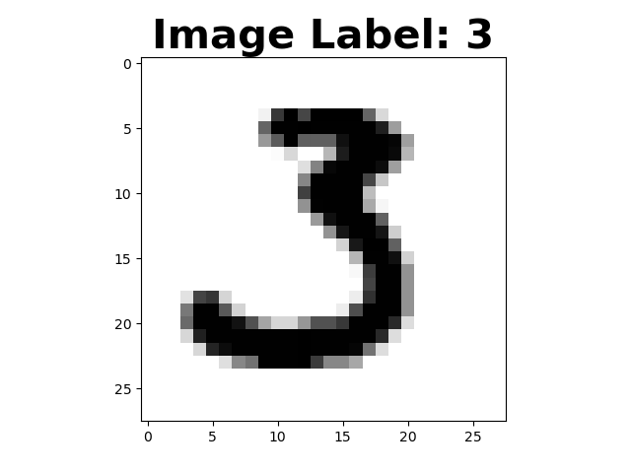
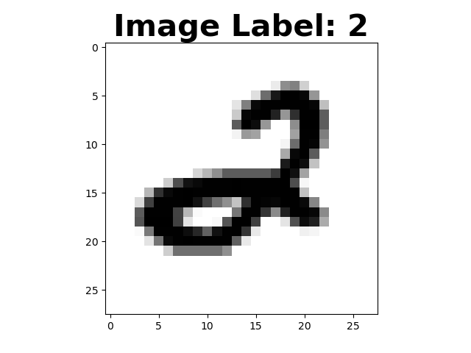
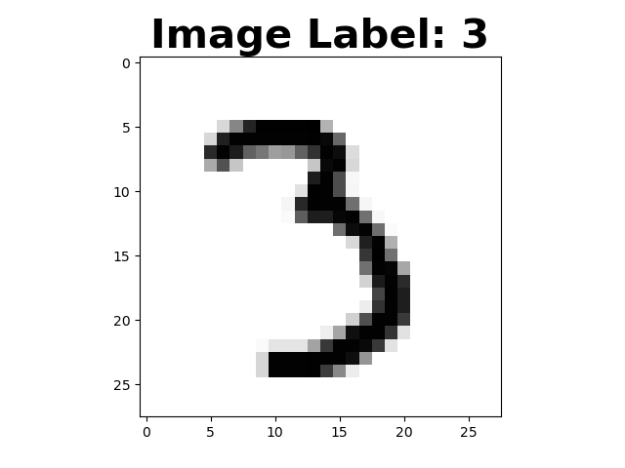
The Control Classifier
Training samples
Testing Samples

Slide 10
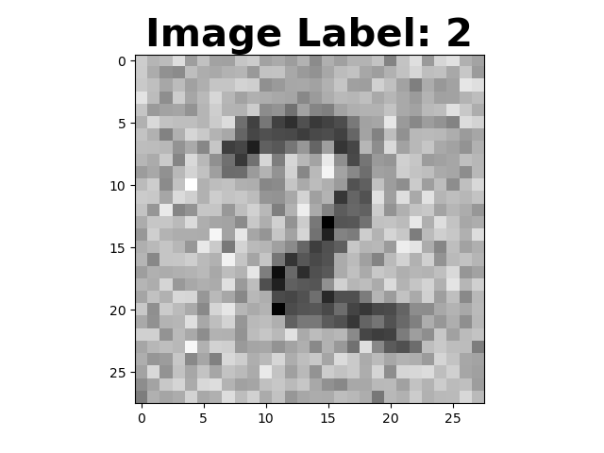
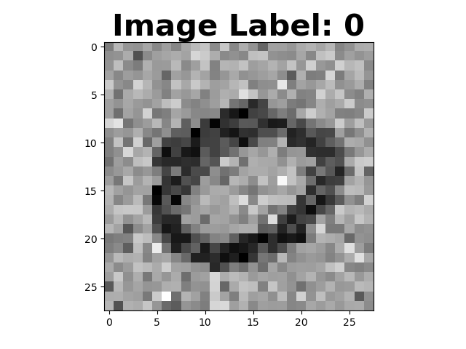
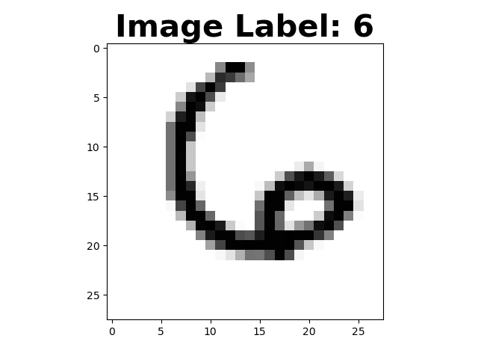
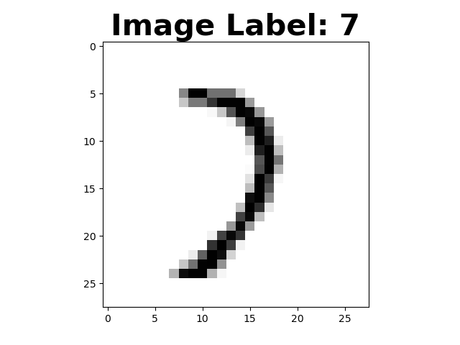
The Noisy – Clean Classifier
Training Samples
Testing Samples

Slide 11
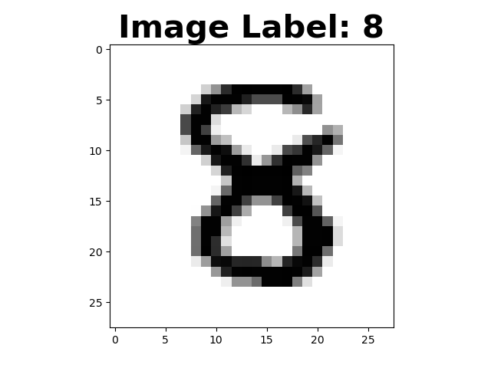
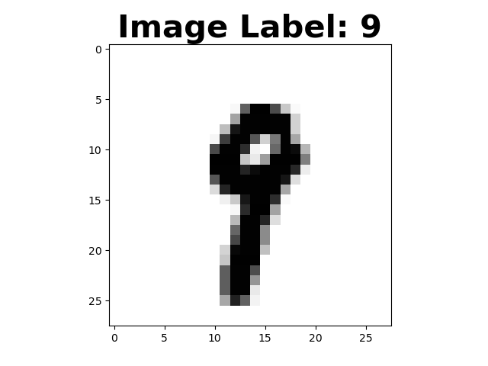
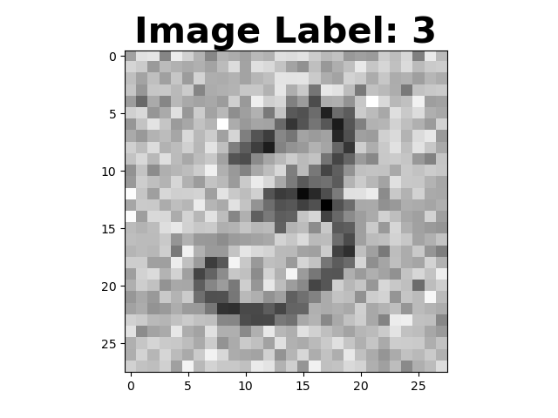
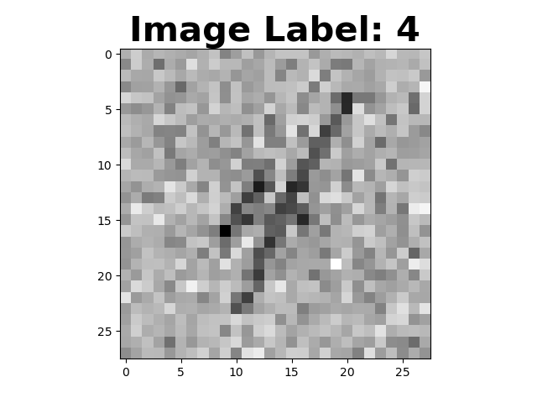
The Clean – Noisy Classifier
Training Samples
Testing Samples

Slide 12
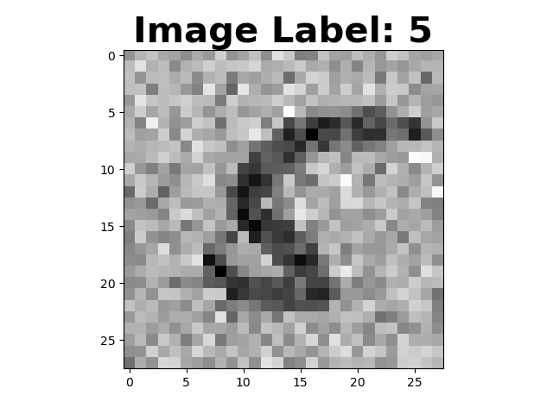
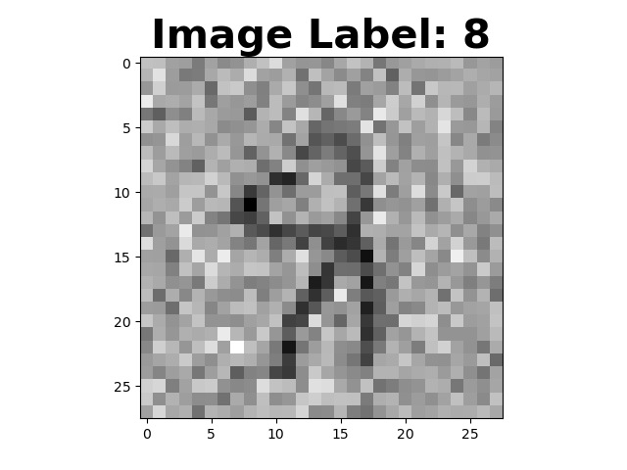
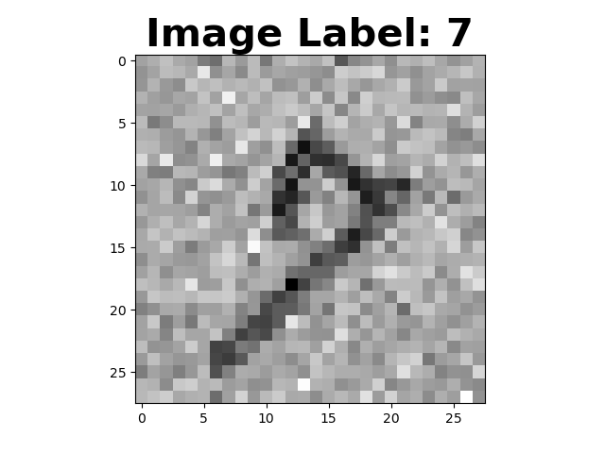
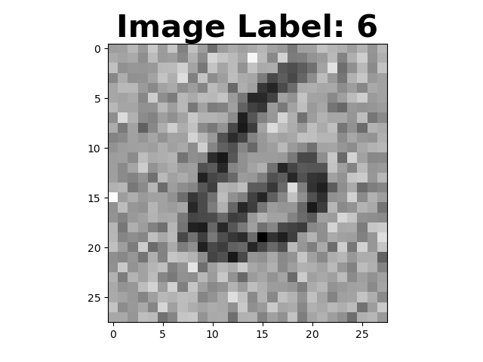
The Noisy Classifier
Training Samples
Testing Samples

